Slide 1
React JS
(uncontrolled components)
Lecture-26

Slide 2
Today’s Agenda
UnControlled Components
Creating Ref
Accessing Ref
Examples

Slide 3
UnControlled Inputs
As discussed previously , an UnControlled Input is similar to traditional HTML based form inputs.
Here, the form data is handled by the DOM itself.
It maintains its own state and will be updated when the input value changes.

Slide 4
UnControlled Inputs
To write an uncontrolled component, there is no need to write an event handler for every state update.
We simply have to use a ref to access the value of the form from the DOM.

Slide 5
What Is Ref ?
We know that , React takes our JSX and constructs the actual DOM, which the browser displays.
A ref holds a reference to this DOM node.
So we can say that it’s a React feature that allows us to store a component or DOM element of our application in a variable and access it programmatically.

Slide 6
How To Create Ref ?
Refs are created using React.createRef() and attached to the React elements via the ref attribute.
Refs are commonly assigned to an instance property when a component is constructed so they can be referenced throughout the component.

Slide 7
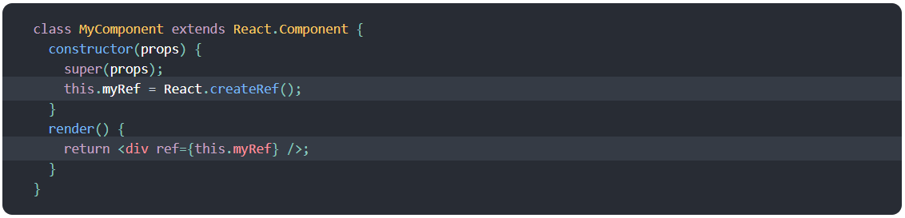
How To Create Ref ?

Slide 8
Accessing Ref
When a ref is passed to an element in render(), a reference to the node becomes accessible using the current attribute of the ref.

Slide 9
Accessing Ref
The value of the current differs depending on the type of the node:
When the ref attribute is used on an HTML element, we get the underlying DOM element as its current property.
When the ref attribute is used on a custom class component, we get the mounted instance of the component as its current.

Slide 10
Exercise
Create a Contact which displays 3 textboxes for inputting username , email and password and after the user types data in these textboxes , and submits the form all the data he has filled must be shown in an alert
Finally after the user dismisses the alert all the textboxes must be cleared and the textbox for username must get the input focus

Slide 11
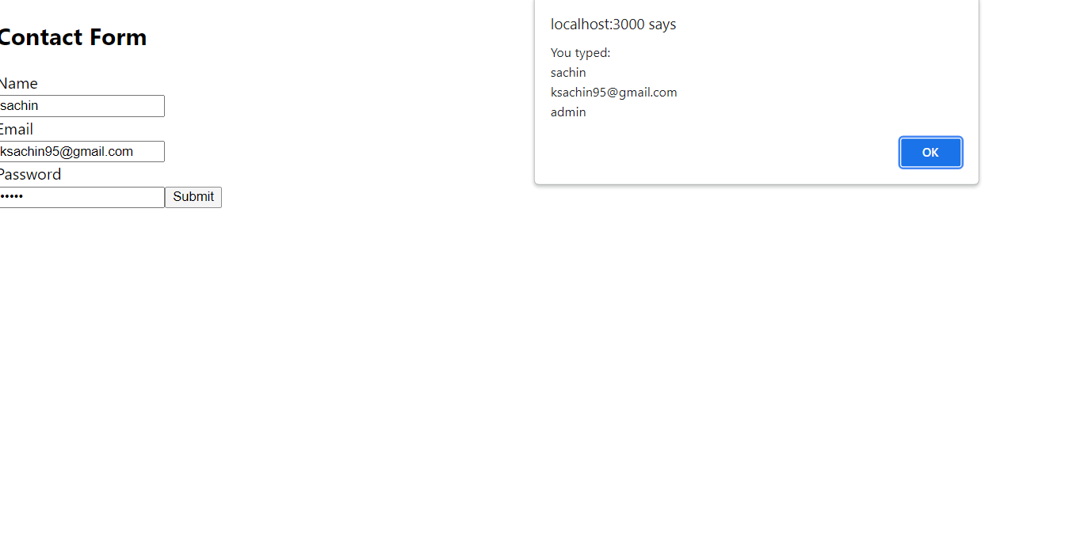
Desired Output

Slide 12
Solution
ContactForm.js
import React, { Component } from "react";
class ContactForm extends Component {
constructor(props) {
super(props);
this.unameref = React.createRef();
this.emailref = React.createRef();
this.pwdref = React.createRef();
this.handleSubmit = this.handleSubmit.bind(this);
}
handleSubmit(evt) {
evt.preventDefault();
alert(
"You typed:\n" +
this.unameref.current.value +
"\n" +
this.emailref.current.value +
"\n" +
this.pwdref.current.value
);
this.unameref.current.value = "";
this.emailref.current.value = "";
this.pwdref.current.value = "";
this.unameref.current.focus();
}

Slide 13
Solution
ContactForm.js
render() {
return (
<div>
<h2>Contact Form</h2>
<form onSubmit={this.handleSubmit}>
<label htmlFor="name">Name</label>
<br />
<input id="name" type="text" ref={this.unameref} />
<br />
<label htmlFor="mailid">Email</label>
<br />
<input id="mailid" type="email" ref={this.emailref} />
<br />
<label htmlFor="pwd">Password</label>
<br />
<input id="pwd" type="password" ref={this.pwdref} />
<button>Submit</button>
</form>
</div>
);
}
}
export default ContactForm;

Slide 14
Solution
App.js
import React, { Component } from "react";
import ContactForm from "./ContactForm";
class App extends Component {
render() {
return (
<div>
<ContactForm />
</div>
);
}
}
export default App;

Slide 15
Creating Ref For Class Component
So far, we have only created refs to DOM nodes in our application.
But it is also possible to create refs to React components, which will give us access to the instance methods of such components.

Slide 16
Creating Ref For Class Component
As usual it is a 4 step process:
Declare an instance variable using createRef() in the parent component
Create the child component in render() of parent component
Assign the instance variable Ref to child component’s ref attribute
In the methods of parent component use this.<ref_name>.current to access whole of the child component

Slide 17
Exercise
Create an App which has 2 components:
MyInput :that simply wraps an <input> element and provides a method for setting focus in the <input> element
MyComponent simply wraps the MyInput component and a button to set the focus in the <input> when clicked.

Slide 18
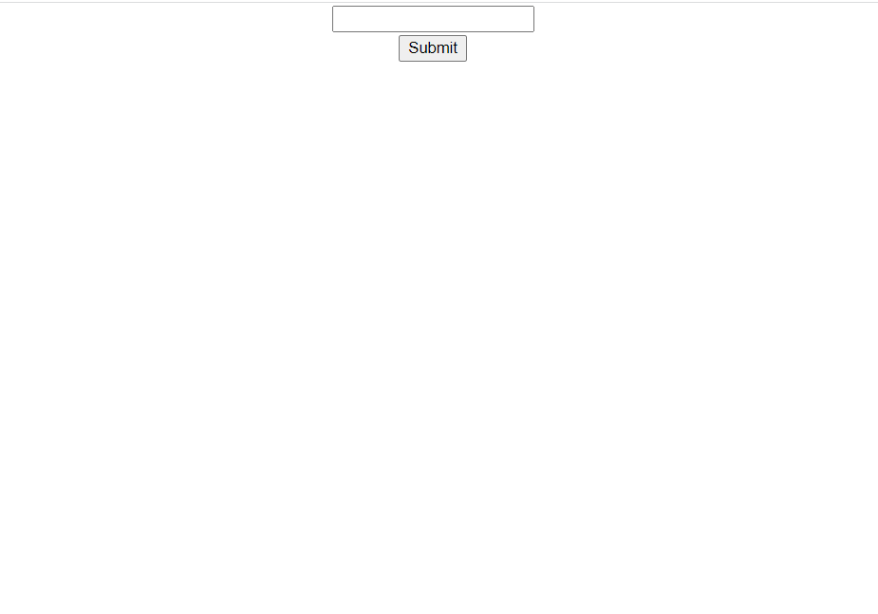
Desired Output

Slide 19
Solution
MyInput.js
import React, { Component } from "react";
class MyInput extends Component {
constructor(props) {
super(props);
this.inputRef = React.createRef();
}
setFocus() {
this.inputRef.current.focus();
}
render() {
return (
<div>
<input type="text" ref={this.inputRef} />
</div>
);
}
}
export default MyInput;

Slide 20
Solution
MyComponent.js
import React, { Component } from "react";
import MyInput from "./MyInput";
class MyComponent extends Component {
constructor(props) {
super(props);
this.compRef = React.createRef();
this.handleClick = this.handleClick.bind(this);
}
handleClick(evt) {
this.compRef.current.setFocus();
}
render() {
return (
<div>
<MyInput ref={this.compRef} />
<button onClick={this.handleClick}>Submit</button>
</div>
);
}
}
export default MyComponent;

Slide 21
Exercise
Create an App which has 2 components:
MyInput component that simply wraps an <input> element and provides two methods. One for knowing whether the input contains some value, and the other for selecting the input text.
MyComponent simply wraps the MyInput component and a button to select the text in the input when clicked if the text is not empty otherwise display an alert with the message that text is empty

Slide 22
Solution
MyInput.js
import React, { Component } from "react";
class MyInput extends Component {
constructor(props) {
super(props);
this.inputRef = React.createRef();
}
selectText() {
this.inputRef.current.select();
}
hasText() {
return this.inputRef.current.value.length > 0;
}
render() {
return (
<div>
<input type="text" ref={this.inputRef} />
</div>
);
}
}
export default MyInput;

Slide 23
Solution
MyComponent.js
import React, { Component } from "react";
import MyInput from "./MyInput";
class MyComponent extends Component {
constructor(props) {
super(props);
this.compRef = React.createRef();
this.handleClick = this.handleClick.bind(this);
}
handleClick(evt) {
if (this.compRef.current.hasText()) {
this.compRef.current.selectText();
} else {
alert("No text in textbox");
}
}
render() {
return (
<div>
<MyInput ref={this.compRef} />
<button onClick={this.handleClick}>Select Text</button>
</div>
);
}
}
export default MyComponent;

Slide 24
Controlled V/s UnControlled
Controlled | UnControlled
It does not maintain its internal state. | It maintains its internal states.
Here, data is controlled by the state or also by parent component. | Here, data is controlled by the DOM itself.
It accepts its current value as a prop. | It uses a ref for its current value.
It has better control over the form elements and data. | It has limited control over the form elements and data.

Slide 25
Facebook Recommendations
Use controlled components whenever possible.
Controlled components do not require a form element in order to be considered a controlled component.
If a component has an input element that has a value attribute bound to state and an event handler to update said state, it is a controlled component.

Slide 26
Facebook Recommendations
Data flow is uni-directional in controlled components with the state within the component acting as the single source of truth.
All state changes within a controlled component should be made via the setState() function.

Slide 27
Facebook Recommendations
Uncontrolled components store their data in the DOM like a traditional HTML input element.
React.createRef() is used to create instance variables within uncontrolled component constructors.
These variables are then associated with input elements via the ref attribute.

